Slide 1
Unit V
Processor Organization
08 Hours
Processor organization, Register organization- user visible registers, control and status registers,Case Study- register organization of microprocessor 8086.
Instruction Cycle- The indirect cycle and Data flow.
Instruction Pipelining- Pipelining Strategy, pipeline performance, pipeline hazards, dealing with branches, Case Study- Intel 586 pipelining.
Instruction level parallelism and superscalar processors- Super scalar verses super pipelined,constraints,
Design Issues- instruction level and machine parallelism, Instruction issue policy, register
renaming, machine parallelism, branch prediction, superscalar execution and implementation.Case study- Pentium 4.

Slide 2
Pipeline Approach to Improve System Performance
Divide process into “stages” and send tasks into a pipeline
Overlap computations of different tasks by operating on them concurrently in different stages
Instruction execution process lends itself naturally to pipelining
overlap the subtasks of instruction fetch, decode and execute

Slide 3
Conventional Pipelined Execution Representation
Time
IFetch
Dcd
Exec
Mem
WB
IFetch
Dcd
Exec
Mem
WB
IFetch
Dcd
Exec
Mem
WB
IFetch
Dcd
Exec
Mem
WB
IFetch
Dcd
Exec
Mem
WB
Program Flow
IFetch
Dcd
Exec
Mem
WB

Slide 4
Single Cycle, Multiple Cycle, vs. Pipeline
Cycle 1
Cycle 2
Clk
Single Cycle Implementation:
Load
Store
Waste
Cycle 1
Cycle 2
Cycle 3
Cycle 4
Cycle 5
Cycle 6
Cycle 7
Cycle 8
Cycle 9
Cycle 10
Clk
Multiple Cycle Implementation:
Load
Store
R-type
Ifetch
Reg
Exec
Mem
Wr
Ifetch
Reg
Exec
Mem
Ifetch
Pipeline Implementation:
Load
Ifetch
Reg
Exec
Mem
Wr
Store
Ifetch
Reg
Exec
Mem
Wr
R-type
Ifetch
Reg
Exec
Mem
Wr
Notes:
Here are the timing diagrams showing the differences between the single cycle, multiple cycle, and pipeline implementations.
For example, in the pipeline implementation, we can finish executing the Load, Store, and R-type instruction sequence in seven cycles.
In the multiple clock cycle implementation, however, we cannot start executing the store until Cycle 6 because we must wait for the load instruction to complete.
Similarly, we cannot start the execution of the R-type instruction until the store instruction has completed its execution in Cycle 9.
In the Single Cycle implementation, the cycle time is set to accommodate the longest instruction, the Load instruction.
Consequently, the cycle time for the Single Cycle implementation can be five times longer than the multiple cycle implementation.
But may be more importantly, since the cycle time has to be long enough for the load instruction, it is too long for the store instruction so the last part of the cycle here is wasted.

Slide 5
Problems with Pipeline processors
Limits to pipelining: Hazards prevent next instruction from executing during its designated clock cycle and introduce stall cycles
Structural hazards: HW cannot support this combination of instructions
Data hazards: Instruction depends on result of prior instruction still in the pipeline
Data dependencies
Control hazards: Caused by delay between the fetching of instructions and decisions about changes in control flow (branches and jumps).
Control dependencies
Can always resolve hazards by stalling
More stall cycles = more CPU time = less performance
Increase performance = decrease stall cycles

Slide 6
Pipeline Hazards
Pipeline hazards
These are situations that inhibit the next instruction can be processed in the next stage of the pipeline.
This leads to an interrupt of the synchronous execution in the pipeline and thus to a performance decrease.
Solution: suspend the execution of the instruction (pipeline stall)
If an instruction is suspended in a certain stage of the pipeline, all subsequent instructions are also stopped.
The pipeline logic inserts NOP operations into the next pipeline stage.
The processing of all earlier instructions is continued.

Slide 7
Resource Hazards
Structural hazards
Result from two instructions that are processed in different stages which require the same resource.
Not all of the components can be replicated to make sure that this never happens.
Examples
Parallel writes to the register file, e.g., if arithmetic operations can write directly and load in the memory access phase.
Parallel access to memory in IF and MA
Subsequent instructions need the FP division hardware that is not implemented as a pipeline.
Notes:
Division: a sequence of two divide operations. If the division is not implemented as a pipeline, the next cannot be started and thus stall cycles are introduced until the second can progress to the execution stage.

Slide 8
Data Hazards and Control Hazards
Data hazards
Instruction access the same data as earlier instructions and these are not yet finished, e.g., an operand computed by a previous instruction is not yet available.
Data hazards result from data dependences between the instructions.
Branch (control) hazards
The next instruction cannot be fetched due to a jump in the control flow.

Slide 9
Resolving Pipeline Hazards
Simple solution is to stop the pipeline
Insertion of NOPs or Pipeline Bubbles.
This reduces the pipeline throughput.
Many techniques in hardware and software have been developed to reduce the effect of hazards on the performance.

Slide 10
Pipeline Hazards and Data Dependences
Data dependences occur between statements in the program.
Example
add R1,R2,R3
sub R4,R5,R6
and R6,R1,R8
xor R9,R1,R11
Notes:
Abhängigkeiten, da Ausgaberegister in MIPS-Assembler als erstes steht.

Slide 11
True dependence (WAR)
True or flow dependence: first write then read
Example
LOOP: load F0,0(R1)
add F4,F0,F2

Slide 12
Anti Dependence(RAW)
Anti dependence (first read then write)
Instruction i reads an operand from a register or memory which is overwritten by a later instruction.
ADD R2,R3,R4
XOR R3,R5,R6

Slide 13
Output Dependence(WAW)
Output dependence (both write)
Instruction i and j write the same register or memory address:
ADD R2,R3,R4
XOR R2,R5,R6
Anti and output dependences are called name dependences.

Slide 14
Dependences and Pipeline Hazards
Data dependences are properties of the program.
It depends on the pipeline organization and the temporal execution of instructions whether data dependences lead to pipeline hazards or not.
Data dependences may induce hazards. Thus, they point out the possibility.
They determine the execution order of instructions.
Independent instructions can be reordered and even executed in parallel.
They determine the maximum degree of parallelism.

Slide 15
Data Hazards
Data hazards can occur if data dependent instructions are executed only with a short delay in the pipeline.
Thus their accesses can overlap in the pipeline.
Example: True dependence
load R1, A
IF
ID
EX
MA
WB
load R2, B
IF
ID
EX
MA
WB
add R2,R1,R2
IF
ID
EX
MA
WB
mul R1,R2,R1
IF
ID
EX
MA
WB
ti
ti+1
ti+2
ti+3
ti+4
Zeit
Notes:
Anti- und Output sind in dieser einfachen Pipeline kein Problem. Sie werden erst bei out-of-order execution ein Problem.

Slide 16
Data Hazards
Example: True dependence
add R2,R1,R2
IF
ID
EX
MA
WB
Read wrong value
R2
alt
R2
neu
mul R1,R2,R1
IF
ID
EX
MA
WB
ti
ti+1
ti+2
ti+3
ti+4
Zeit

Slide 17
Data Hazards Classification
insti
…
instj
Read-after-write (RAW)
Happens if instruction j reads a source register before instruction i wrote
its result.
Implied by a true dependence.
Write-after-Read (WAR)
Happens if instruction j writes the target register before instruction i reads the operand.
Implied by an anti dependence
Write-after-Write (WAW)
Happens if instruction j writes its target register before instruction i wrote its result to the same register.
Implied by an output dependence.
Can happen in pipelines where multiple stages can write or an instruction can proceed without waiting for a stalled previous instruction.

Slide 18
Technique | Reduces
Loop Unrolling | Control Stalls
Basic Pipeline Scheduling | RAW Stalls
Dynamic Scheduling with Score boarding | RAW stalls
Dynamic Scheduling with Register Renaming | WAR and WAW stalls
Dynamic Branch Prediction | Control Stalls
Issue Multiple Instructions per Cycle | Ideal CPI
Compiler Dependence Analysis | Ideal CPI & data stalls
Software pipelining and trace scheduling | Ideal CPI & data stalls
Speculation | All data & control stalls
Dynamic memory disambiguation | RAW stalls involving memory

Slide 19
Static vs. Dynamic Scheduling
Static scheduling:
Fetches an instruction and issues it handles data dependence by forwarding stalls the pipeline until the dependence is cleared
when forwarding cannot resolve the hazard No new instructions are fetched or issued until dependence is clear
Dynamic scheduling:
hardware re-arranges the instruction execution to reduce the stalls while maintaining data flow and exception behavior

Slide 20
Scoreboard Introduction
Score boarding is a technique for allowing instructions to execute out of order when there are sufficient resources and no data dependences

Slide 21
Scoreboard is able to handle all data hazards
The goal of scoreboard is to maintain an execution rate of one instruction per clock cycle (when there are no structural hazards) by executing an instruction as early as possible.
The scoreboard is responsible for instruction issue and execution, including all hazard detection

Slide 22
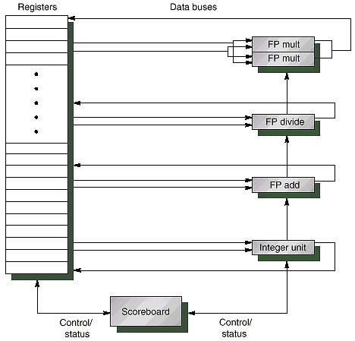
Typical Scoreboard Structure

Slide 23
What Does Scoreboard Do?
Every instruction goes through scoreboard, where a record of data dependences is constructed instruction issue
Scoreboard then determines when operands are readable and begin execution: if not executable, it monitors changes
Scoreboard also controls when an instruction can write to a register
All hazard detection and resolution is centralized in scoreboard
It replaces ID, EX, and WB steps in the standard pipeline

Slide 24
Step 1: Issue
An instruction is issued when the FU for the instruction is free and no other active instruction has the same destination register
This eliminates WAW hazard If a structural or WAW hazard exists instruction issue stalls, no further instruction will issue until hazards are cleared
It causes the buffer between IF and issue to fill; IF stalls when buffer is full

Slide 25
Step 2: Read Operands
Scoreboard monitors the availability of source operands. When source operands are available, scoreboard tells the FU to proceed to read it
A source operand is available if no earlier issued active instruction is going to write it
This resolves RAW hazards
Step 1 & 2 replaces ID stage in pipeline

Slide 26
Step 3: Execution
FU begins execution upon receiving operands When the result is ready, it notifies scoreboard
This replaces EX step in pipeline and takes multiple cycles in FP pipeline

Slide 27
Step 4: Write Result
Once scoreboard is aware that the FU has completed execution, it checks for WAR hazards and stalls the completing instruction when necessary
DIV.D F0, F2, F4
ADD.D F10, F0, F8
SUB.D F8, F8, F14
The scoreboard will stall the SUB.D in its Write Result stage until ADD.D reads its operands
In general, a completing instruction cannot write its result when there is an instruction that has not read its operands that precedes (in order of issue) the completing instruction and one operand is the same as the result register Otherwise, scoreboard tells the FU to store its result to the destination register replaces WB step

Slide 28
No Forwarding in Scoreboard?
Since operands are read only from register file, this scoreboard doesn’t use forwarding
However, instructions will write their result into the register file (assuming no WAR hazards), rather than the static assigned “write” cycle
Reduced pipeline latency and benefits of forwarding
There is still 1 cycle of latency involved since the “write result” and “read operand” stages cannot overlap

Slide 29
Limitations of Scoreboard
In eliminating stalls, a scoreboard is limited by several factors:
the amount of parallelism available
number of scoreboard entries
number and types of Bus
Potential WAW and WAR hazards

Slide 30
Register Renaming
register renaming (in hardware)
• change register names to eliminate WAR/WAW hazards
• one of the most elegant concepts in computer architecture key: think of architectural registers as names, not locations
• can have more locations than names
• dynamically map names to locations
• map table holds the current mappings (name®location)
• write: allocate new location and record it in map table
• read: find location of most recent write by name lookup in map table
• minor detail: must de-allocate locations appropriately

Slide 31
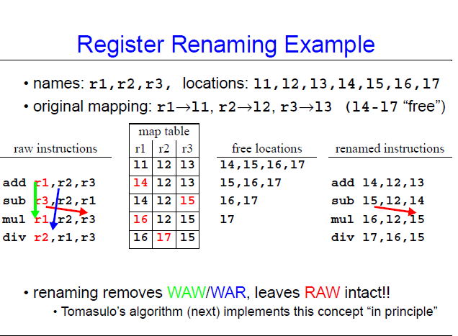

Slide 32
Branch Hazards
JUMP
IF
ID
EX
MA
WB
PC
Target
stall
stall
stall
IF
ID
EX
MA
WB
Zeit
Stall cycles

Slide 33
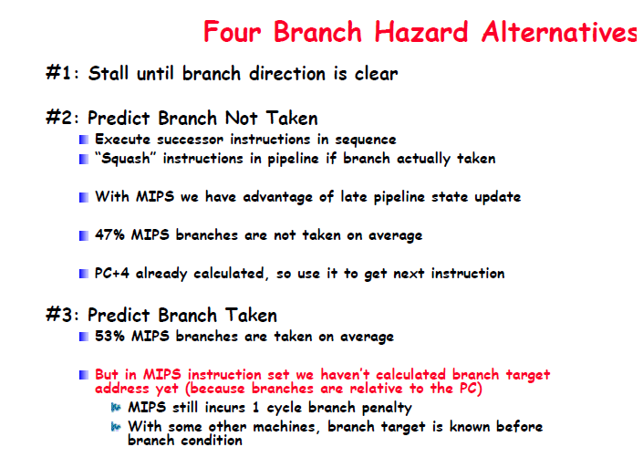

Slide 34
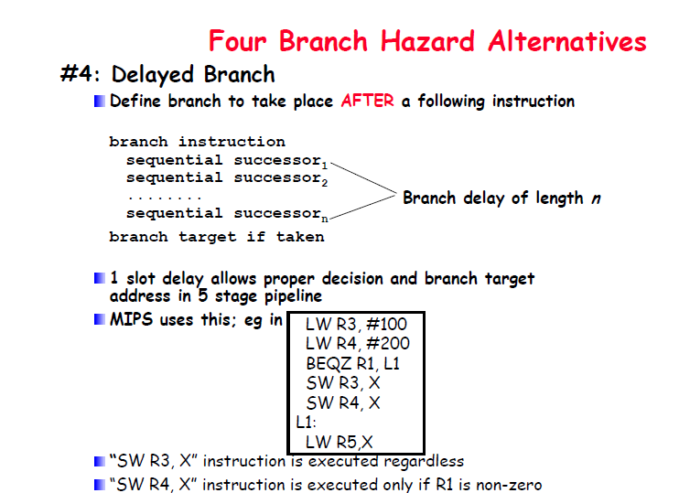

Slide 35
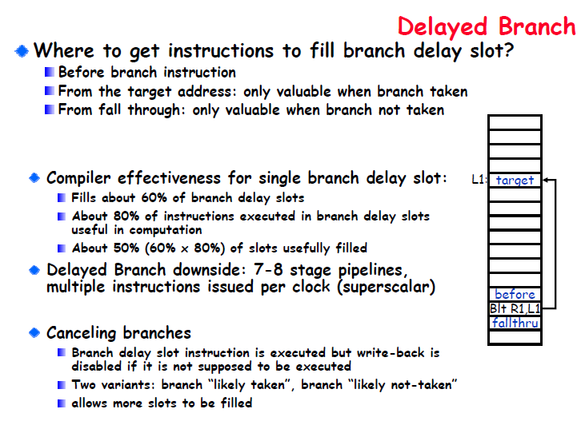

Slide 36
Branch Prediction
Prediction of branch decision when a jump is encountered.
Speculative execution of instructions dependent on the predicted outcome.
After the condition was computed
Either continue without delay since the prediction was correct
or delete the started instructions and fetch the correct ones.
Two classes
Static branch prediction by hardware or compiler
Dynamic branch prediciton by the hardware
Notes:
Static prediction: always predict taken. Good for loops.

Slide 37
Static Branch Prediction
Hardware
Static prediction in processor, backward jumps are predicted to be always taken.
Compiler
Specification via a bit in the jump opcode
Prediction can be guided by program analysis or profiling (feedback directed compilation)

Slide 38
Dynamic Branch Prediction
Properties
Based on dynamic behavior of the application
The history of a jump is taken into account.
Leads to more precise predictions
Expensive in terms of hardware
Branch Prediction Buffer
Cache for information about conditional jumps
Requires that the target can be computed fast
Notes:
Zieladresse kann schnell berechnet werden: Ist unabhängig von Register und Addierer für PC-relative Adressierung steht im Dekodierer zur Verfügung.

Slide 39

Performance reduced due to program transfer instructions JMP, Jcc, Call, Ret Pipelines required to be cleared.
Causes bubbles in pipeline, no work till reloaded
Prediction of branch instruction in pipeline is done
If prediction is true then pipeline will not be cleared and no clock cycles will be lost

Slide 40
Branch Target Buffer is a special cache that stores the instruction and target addresses of any branch instruction of any branch instruction along with 2 history bits indicates execution history of last two branch instructions.
If history bit is 00 then prediction is not taken and taken for other values
Two 32 bytes prefetch buffers work with BTB, one buffer prefetches instructions from current program address and other is activated when BTB predicts TAKEN during D1 stage and prefetch instructions from branch address

Slide 41

NT
H:11
P: T
H:10
P: T
T
T
T
T
NT
H:00
P: NT
NT
H:01
P: T
NT
H : History Bit
P : Prediction
T : Branch is Taken
NT : Branch is not Taken

Slide 42
There are two typical approaches, in order to
improve performance:
1. Super pipelining
2. Superscalar

Slide 43
What is a Superscalar Architecture?
• A superscalar architecture is one in which several instructions can be initiated simultaneously and executed independently.
• Pipelining allows several instructions to be executed at the same time, but they have to be in different pipeline stages at a given moment.
• Superscalar architectures include all features of pipelining but, in addition, there can be several instructions executing simultaneously in the same pipeline stage.
They have the ability to initiate multiple instructions during the same clock cycle.

Slide 44
Superscalar Architectures
• Superscalar architectures allow several instructions to be issued and completed per clock cycle.
• A superscalar architecture consists of a number of pipelines that are working in parallel.
• Depending on the number and kind of parallel units available, a certain number of instructions can be executed in parallel.

Slide 45
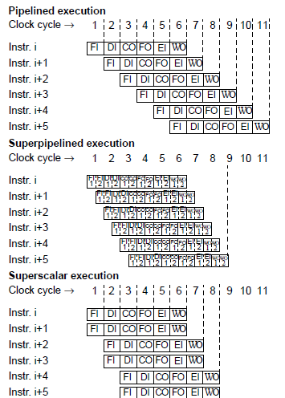

Slide 46
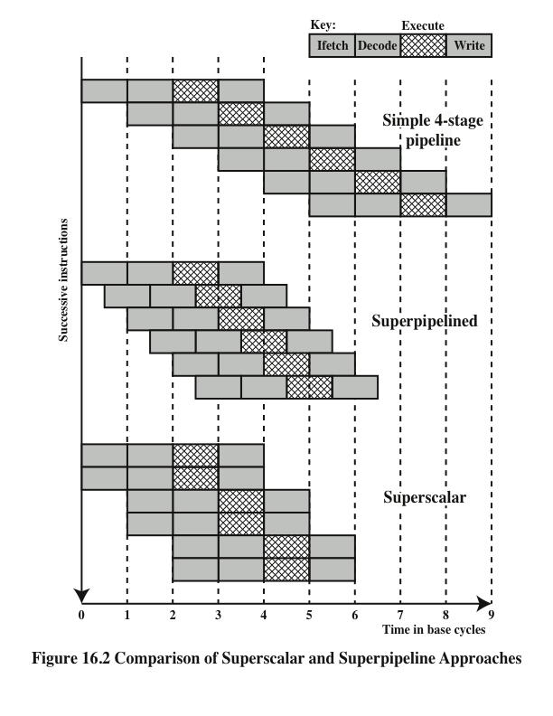
Comparison
of Superscalar
and
Superpipeline Approaches
Notes:
An alternative approach to achieving greater performance is referred to as super- pipelining, a term first coined in 1988 [JOUP88]. Superpipelining exploits the fact that many pipeline stages perform tasks that require less than half a clock cycle. Thus, a doubled internal clock speed allows the performance of two tasks in one external clock cycle. We have seen one example of this approach with the MIPS R4000.
Figure 16.2 compares the two approaches. The upper part of the diagram illustrates an ordinary pipeline, used as a base for comparison. The base pipeline issues one instruction per clock cycle and can perform one pipeline stage per clock cycle. The pipeline has four stages: instruction fetch, operation decode, operation execution, and result write back. The execution stage is crosshatched for clarity. Note that although several instructions are executing concurrently, only one instruction is in its execution stage at any one time.
The next part of the diagram shows a superpipelined implementation that is capable of performing two pipeline stages per clock cycle. An alternative way of looking at this is that the functions performed in each stage can be split into two non-overlapping parts and each can execute in half a clock cycle. A superpipeline implementation that behaves in this fashion is said to be of degree 2. Finally, the lowest part of the diagram shows a superscalar implementation capable of executing two instances of each stage in parallel. Higher-degree superpipeline and super- scalar implementations are of course possible.
Both the superpipeline and the superscalar implementations depicted in Figure 16.2 have the same number of instructions executing at the same time in the steady state. The superpipelined processor falls behind the superscalar processor at the start of the program and at each branch target.

Slide 47
Constraints
Instruction level parallelism
Refers to the degree to which the instructions of a program can be executed in parallel
A combination of compiler based optimization and hardware techniques can be used to maximize instruction level parallelism
Limitations:
True data dependency
Procedural dependency
Resource conflicts
Output dependency
Antidependency
Notes:
The superscalar approach depends on the ability to execute multiple instructions in parallel. The term instruction-level parallelism refers to the degree to which, on average, the instructions of a program can be executed in parallel. A combination of compiler-based optimization and hardware techniques can be used to maximize instruction-level parallelism. Before examining the design techniques used in super- scalar machines to increase instruction-level parallelism, we need to look at the fundamental limitations to parallelism with which the system must cope. [JOHN91] lists five limitations:
• True data dependency
• Procedural dependency
• Resource conflicts
• Output dependency
• Antidependency

Slide 48
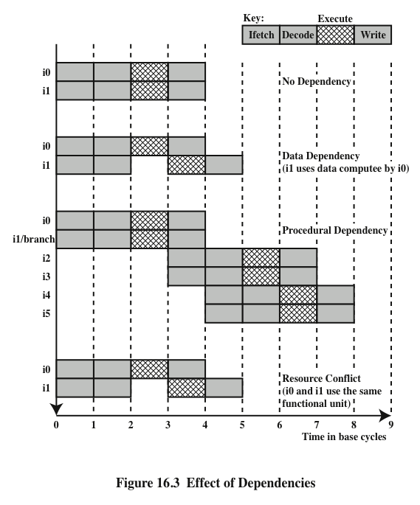
Effect of
Dependencies
Notes:
As was discussed in Chapter 14, the presence of branches in an instruction sequence complicates the pipeline operation. The instructions following a branch (taken or not taken) have a procedural dependency on the branch and cannot be executed until the branch is executed. Figure 16.3 illustrates the effect of a branch on a superscalar pipeline of degree 2.
As we have seen, this type of procedural dependency also affects a scalar pipe- line. The consequence for a superscalar pipeline is more severe, because a greater magnitude of opportunity is lost with each delay.
If variable-length instructions are used, then another sort of procedural dependency arises. Because the length of any particular instruction is not known, it must be at least partially decoded before the following instruction can be fetched. This prevents the simultaneous fetching required in a superscalar pipeline. This is one of the reasons that superscalar techniques are more readily applicable to a RISC or RISC-like architecture, with its fixed instruction length.
A resource conflict is a competition of two or more instructions for the same resource at the same time. Examples of resources include memories, caches, buses, register-file ports, and functional units (e.g., ALU adder).
In terms of the pipeline, a resource conflict exhibits similar behavior to a data dependency (Figure 16.3). There are some differences, however. For one thing, re- source conflicts can be overcome by duplication of resources, whereas a true data dependency cannot be eliminated. Also, when an operation takes a long time to complete, resource conflicts can be minimized by pipelining the appropriate functional unit.

Slide 49
What is Good and what is Bad with Superscalar ?
Good •
The hardware solves everything: - Hardware detects potential parallelism between instructions; - Hardware tries to issue as many instructions as possible in parallel. - Hardware solves register renaming.
• Binary compatibility
- If functional units are added in a new version of the architecture or some other improvements have been made to the architecture (without changing the instruction sets), old programs can benefit from the additional potential of parallelism. Why? Because the new hardware will issue the old instruction sequence in a more efficient way.
Bad
• Very complex - Much hardware is needed for run-time detection. There is a limit in how far we can go with this technique.
• The window of execution is limited this limits the capacity to detect potentially parallel instructions

Slide 50
Design Issues
Instruction-Level Parallelism
and Machine Parallelism
Instruction level parallelism
Instructions in a sequence are independent
Execution can be overlapped
Governed by data and procedural dependency
Machine Parallelism
Ability to take advantage of instruction level parallelism
Governed by number of parallel pipelines
Notes:
[JOUP89a] makes an important distinction between the two related concepts of instruction-level parallelism and machine parallelism. Instruction-level parallelism exists when instructions in a sequence are independent and thus can be executed in parallel by overlapping.
The degree of instruction-level parallelism is determined by the frequency of true data dependencies and procedural dependencies in the code. These factors, in turn, are dependent on the instruction set architecture and on the application. Instruction-level parallelism is also determined by what [JOUP89a] refers to as operation latency: the time until the result of an instruction is available for use as an operand in a subsequent instruction. The latency determines how much of a delay a data or procedural dependency will cause.
Machine parallelism is a measure of the ability of the processor to take advantage of instruction-level parallelism. Machine parallelism is determined by the number of instructions that can be fetched and executed at the same time (the number of parallel pipelines) and by the speed and sophistication of the mechanisms that the processor uses to find independent instructions.
Both instruction-level and machine parallelism are important factors in enhancing performance. A program may not have enough instruction-level parallel- ism to take full advantage of machine parallelism. The use of a fixed-length instruction set architecture, as in a RISC, enhances instruction-level parallelism. On the other hand, limited machine parallelism will limit performance no matter what the nature of the program.

Slide 51
Instruction Issue Policy
Instruction issue
Refers to the process of initiating instruction execution in the processor’s functional units
Instruction issue policy
Refers to the protocol used to issue instructions
Instruction issue occurs when instruction moves from the decode stage of the pipeline to the first execute stage of the pipeline
Three types of orderings are important:
The order in which instructions are fetched
The order in which instructions are executed
The order in which instructions update the contents of register and memory locations
Superscalar instruction issue policies can be grouped into the following categories:
In-order issue with in-order completion
In-order issue with out-of-order completion
Out-of-order issue with out-of-order completion
Notes:
As was mentioned, machine parallelism is not simply a matter of having multiple instances of each pipeline stage. The processor must also be able to identify instruction-level parallelism and orchestrate the fetching, decoding, and execution of instructions in parallel. [JOHN91] uses the term instruction issue to refer to the process of initiating instruction execution in the processor’s functional units and the term instruction issue policy to refer to the protocol used to issue instructions. In general, we can say that instruction issue occurs when instruction moves from the decode stage of the pipeline to the first execute stage of the pipeline.
In general terms, we can group superscalar instruction issue policies into the
following categories:
• In-order issue with in-order completion
• In-order issue with out-of-order completion
• Out-of-order issue with out-of-order completion
In essence, the processor is trying to look ahead of the current point of execution to locate instructions that can be brought into the pipeline and executed. Three types of orderings are important in this regard:
The order in which instructions are fetched
The order in which instructions are executed
The order in which instructions update the contents of register and memory locations
The more sophisticated the processor, the less it is bound by a strict relation- ship between these orderings. To optimize utilization of the various pipeline elements, the processor will need to alter one or more of these orderings with respect to the ordering to be found in a strict sequential execution. The one constraint on the processor is that the result must be correct. Thus, the processor must accommodate the various dependencies and conflicts discussed earlier.

Slide 52
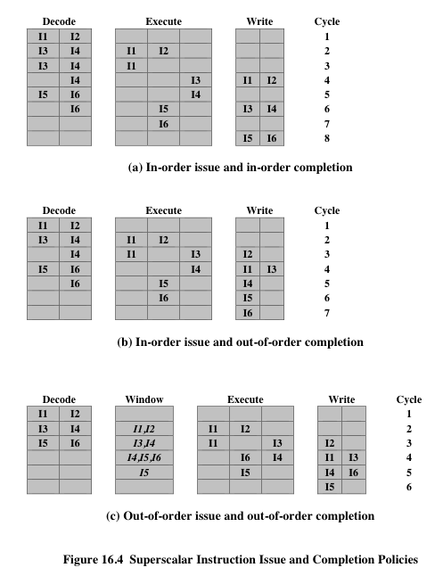
Superscalar Instruction Issue and Completion Policies
Notes:
The simplest instruction issue policy is to issue instructions in the exact order that would be achieved by sequential execution (in-order issue) and to write results in that same order (in-order completion). Not even scalar pipelines follow such a simple-minded policy. However, it is useful to consider this policy as a baseline for comparing more sophisticated approaches.
Figure 16.4a gives an example of this policy. We assume a superscalar pipeline capable of fetching and decoding two instructions at a time, having three separate functional units (e.g., two integer arithmetic and one floating-point arithmetic), and having two instances of the write-back pipeline stage. The example assumes the fol- lowing constraints on a six-instruction code fragment:
I1 requires two cycles to execute.
I3 and I4 conflict for the same functional unit.
I5 depends on the value produced by I4.
I5 and I6 conflict for a functional unit.
Instructions are fetched two at a time and passed to the decode unit. Because instructions are fetched in pairs, the next two instructions must wait until the pair of decode pipeline stages has cleared. To guarantee in-order completion, when there is a conflict for a functional unit or when a functional unit requires more than one cycle to generate a result, the issuing of instructions temporarily stalls.
In this example, the elapsed time from decoding the first instruction to writing the last results is eight cycles.
Out-of-order completion is used in scalar RISC processors to improve the performance of instructions that require multiple cycles. Figure 16.4b illustrates its use on a superscalar processor. Instruction I2 is allowed to run to completion prior to I1. This allows I3 to be completed earlier, with the net result of a savings of one cycle.
With out-of-order completion, any number of instructions may be in the execution stage at any one time, up to the maximum degree of machine parallelism across all functional units. Instruction issuing is stalled by a resource conflict, a data dependency, or a procedural dependency.
In addition to the aforementioned limitations, a new dependency, which we referred to earlier as an output dependency (also called write after write [WAW] dependency), arises.
Instruction I2 cannot execute before instruction I1, because it needs the result in register R3 produced in I1; this is an example of a true data dependency, as described in Section 16.1. Similarly, I4 must wait for I3, because it uses a result produced by I3. What about the relationship between I1 and I3? There is no data dependency here, as we have defined it. However, if I3 executes to completion prior to I1, then the wrong value of the contents of R3 will be fetched for the execution of I4. Consequently, I3 must complete after I1 to produce the correct output values. To ensure this, the issuing of the third instruction must be stalled if its result might later be overwritten by an older instruction that takes longer to complete.
Out-of-order completion requires more complex instruction issue logic than in-order completion. In addition, it is more difficult to deal with instruction interrupts and exceptions. When an interrupt occurs, instruction execution at the current point is suspended, to be resumed later. The processor must assure that the resumption takes into account that, at the time of interruption, instructions ahead of the instruction that caused the interrupt may already have completed.

